Slide 1
Chapter 9: Virtual Memory

Slide 2
Chapter 9: Virtual Memory
Background
Demand Paging
Process Creation
Page Replacement
Allocation of Frames
Thrashing
Demand Segmentation
Operating System Examples

Slide 3
Background
Virtual Memory is a technique that allows the execution of processes that are not completely in memory.
One major advantage of this scheme is that programs can be larger than physical memory.

Slide 4
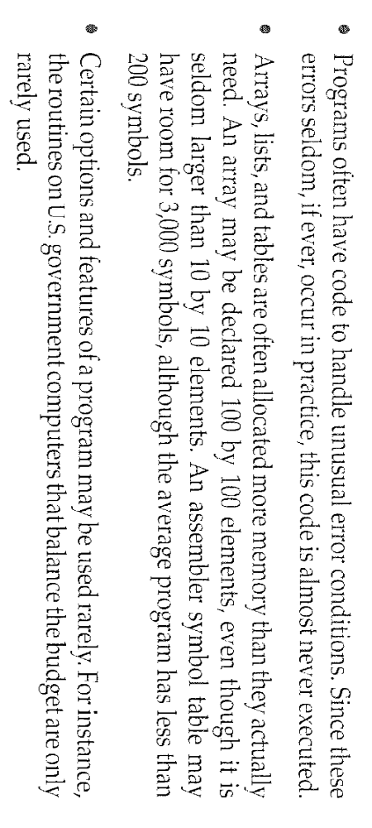
Background
In many cases the entire program is not needed to load in memory.

Slide 5
Background
Virtual memory – separation of user logical memory from physical memory.
  Only part of the program needs to be in memory for execution.
  Logical address space can therefore be much larger than physical address space.
  Allows address spaces to be shared by several processes.
  Allows for more efficient process creation.
Virtual memory can be implemented via:
  Demand paging
  Demand segmentation

Slide 6
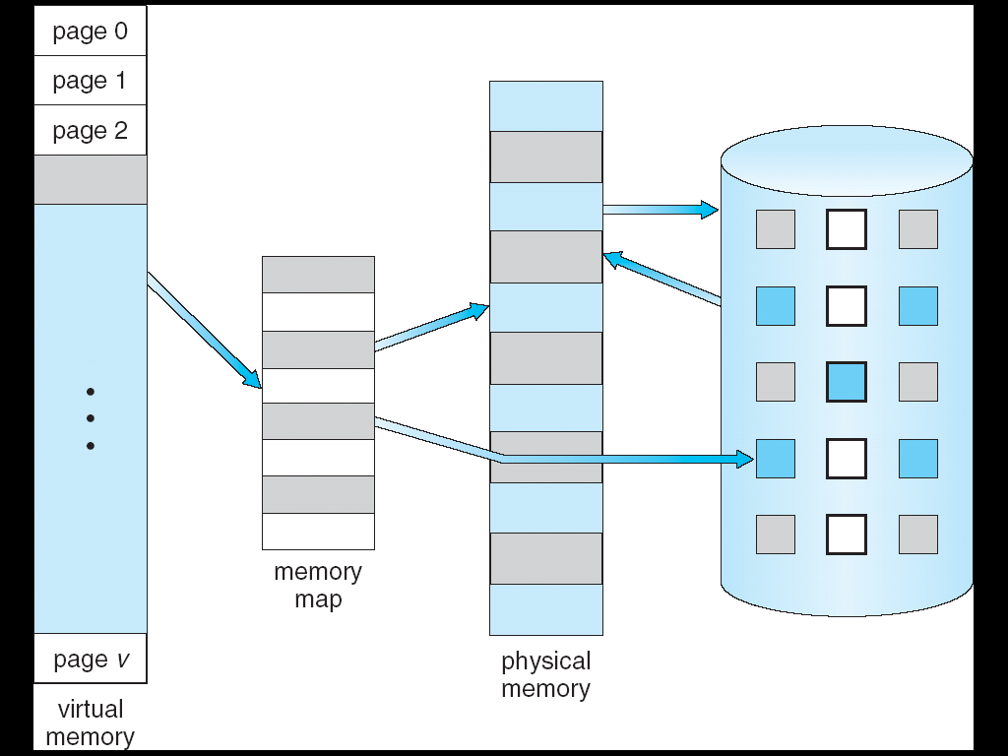
Virtual Memory That is Larger Than Physical Memory
⇒

Slide 7

Virtual-address Space
The virtual address space of
a process refers to the logical
(or virtual ) view of how a
process is stored in memory.
Sparse address spaces.

Slide 8

Shared Library Using Virtual Memory
Virtual memory also allows files and memory to be shared
by two or mores processes through page sharing.

Slide 9
Demand Paging
Loading the entire program into memory results in loading the executable code for all options , regardless of whether an option is ultimately selected by the user or not.
An alternative strategy is to initially load pages only as they are needed. This technique is known as demand paging and is commonly used in virtual memory systems.

Slide 10
Demand Paging
Bring a page into memory only when it is needed
  Less I/O needed
  Less memory needed
  Faster response
  More users
Page is needed ⇒ reference to it
  invalid reference ⇒ abort
  not-in-memory ⇒ bring to memory

Slide 11
Demand Paging
In demand-paged virtual memory ,
  Pages are only loaded when they are demanded during program execution.
  Pages that are never accessed are thus never loaded into physical memory.
A demand-paging system is similar to a paging system with swapping where processes reside in secondary memory (usually a disk).
Lazy swapper : A lazy swapper never swaps a page into memory unless that page will be needed.
A swapper manipulates entire processes, where as a pager is concerned with the individual pages of a process.

Slide 12
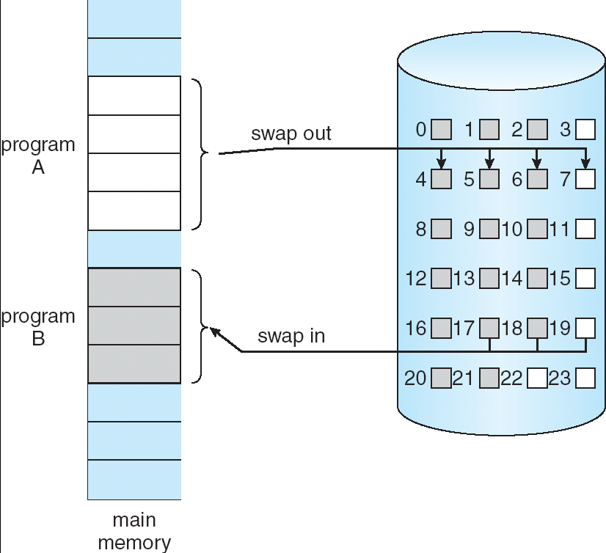
Transfer of a Paged Memory to Contiguous Disk Space

Slide 13
Valid-Invalid Bit
We need some from of hardware support to distinguish between the pages that are in memory and the pages that are on the disk.
The valid – invalid bit scheme can be used for this purpose.
With each page table entry a valid–invalid bit is associated
(1 ⇒ in-memory, 0 ⇒ not-in-memory)
Initially valid–invalid but is set to 0 on all entries

Slide 14
Valid-Invalid Bit
Example of a page table snapshot:
During address translation, if valid–invalid bit in page table entry is 0 ⇒ page fault
Frame #
valid-invalid bit
1
1
1
1
0

0
0
page table

Slide 15

Page Table When Some Pages Are Not in Main Memory

Slide 16
Page Fault
If a process tries to access a page that was not brought into memory or
Access to a page marked invalid causes a page-fault trap.
The trap is the result of the operating system’s failure to bring the desired page into memory.

Slide 17
Page Fault
If there is ever a reference to a page, first reference will trap to
OS ⇒ page fault
OS looks at another table to decide:
  Invalid reference ⇒ abort.
  Just not in memory.
Get empty frame.
Swap page into frame.
Reset tables, validation bit = 1.
Restart instruction: Least Recently Used
  block move
  auto increment/decrement location

Slide 18
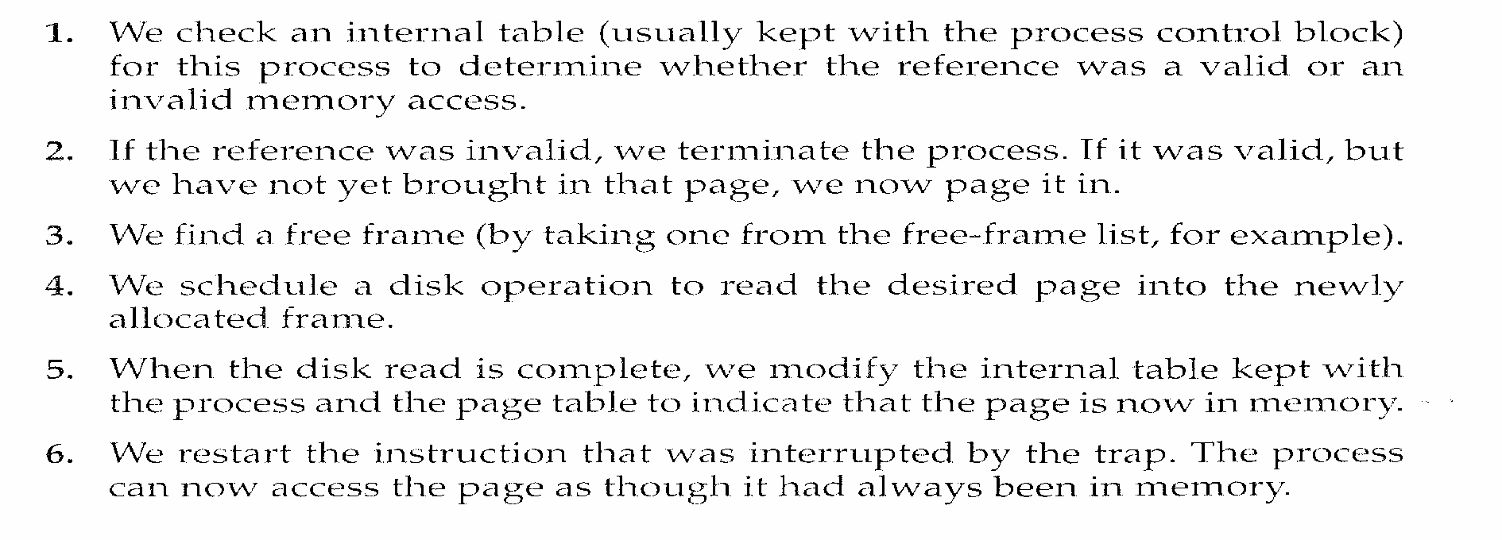

Slide 19

Steps in Handling a Page Fault

Slide 20
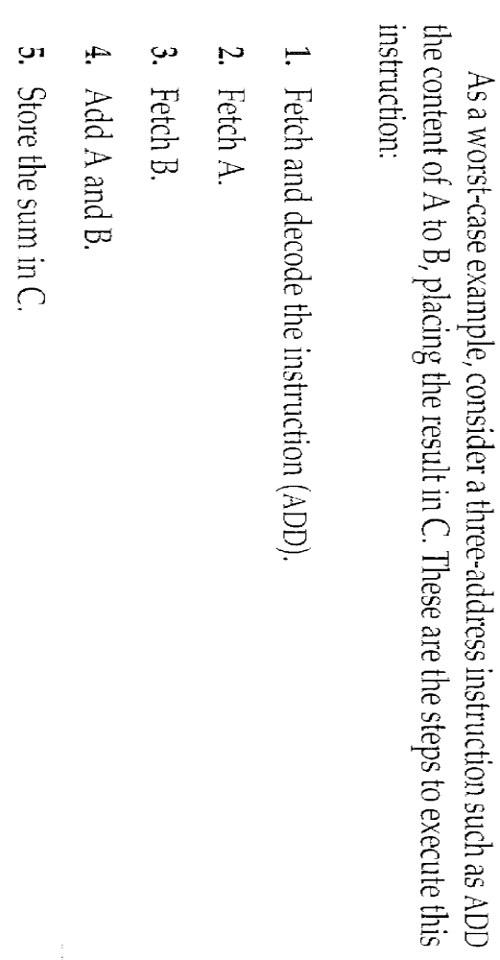
Special case
A crucial requirement for demand paging is the need to be able to restart any instruction after a page fault .

Slide 21
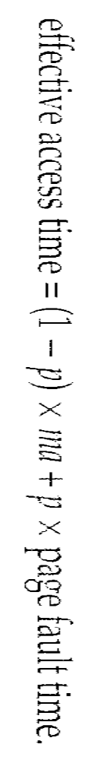
Performance of Demand Paging
Page Fault Rate 0 ≤ p ≤ 1.0
  if p = 0 no page faults
  if p = 1, every reference is a fault
Effective Access Time (EAT)
ma → memory-access time.
p → The probability of a page fault (0 <= p <= 1)

Slide 22
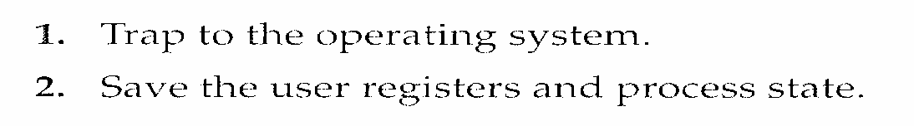
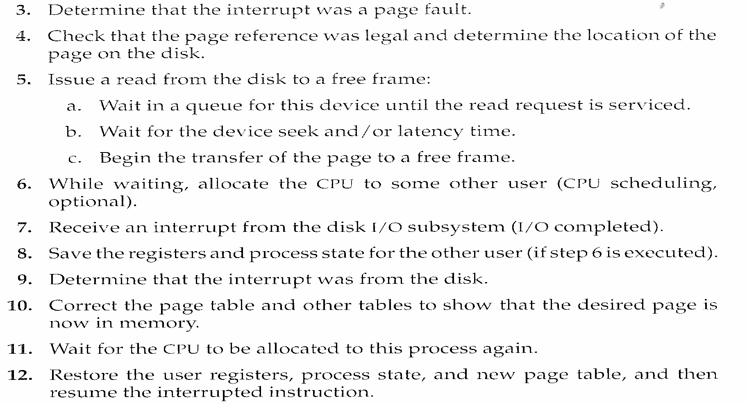

Slide 23
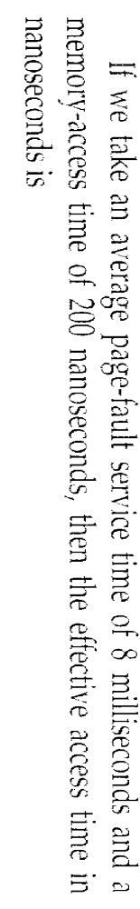
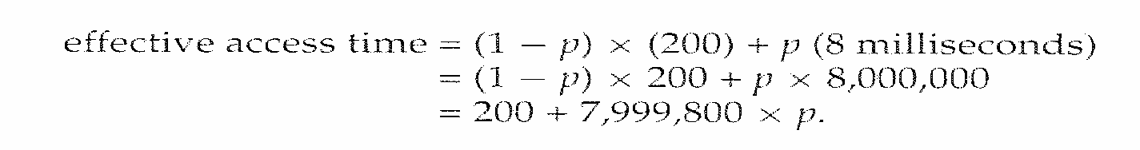
Demand Paging Example

Slide 24
Process Creation
Virtual memory allows other benefits during process creation:
- Copy-on-Write
- Memory-Mapped Files (later)

Slide 25
Copy-on-Write
Copy-on-Write (COW) allows both parent and child processes to initially share the same pages in memory
If either process modifies a shared page, only then is the page copied
COW allows more efficient process creation as only modified pages are copied
Free pages are allocated from a pool of zeroed-out pages

Slide 26
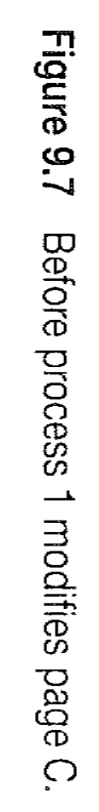
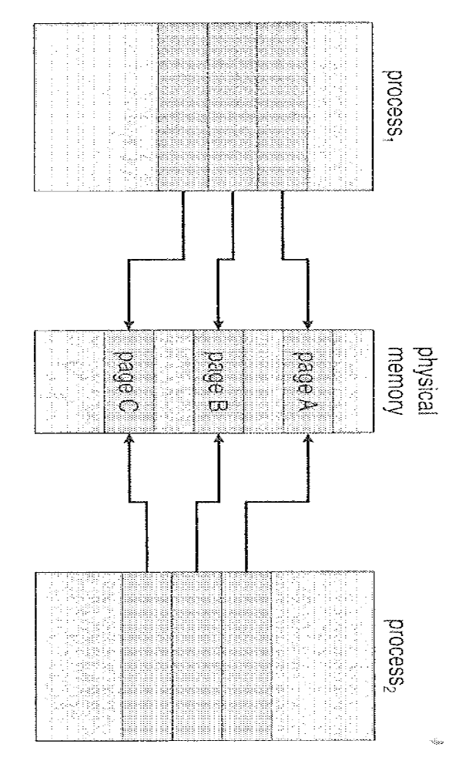
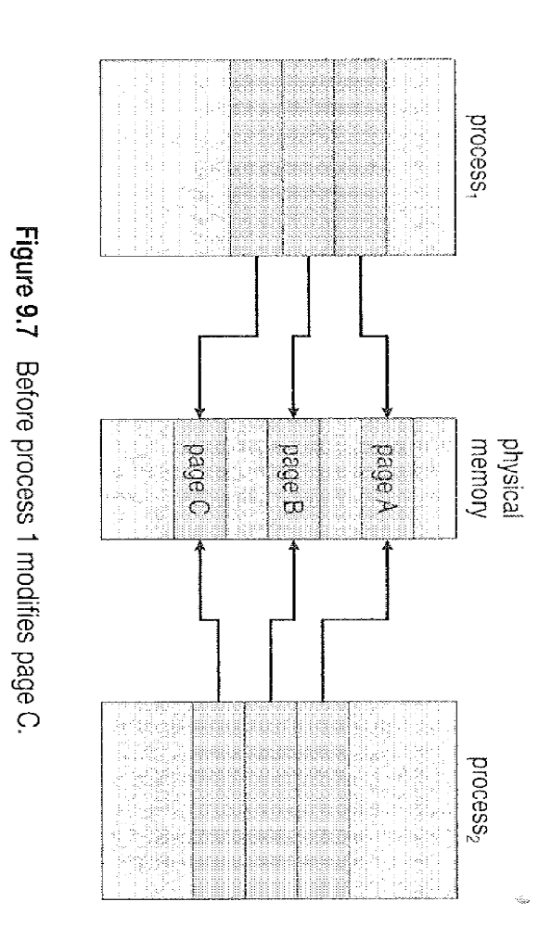

Slide 27
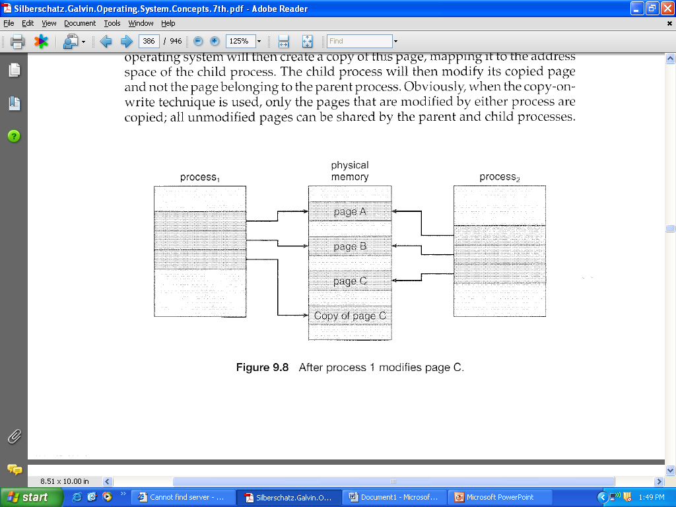

Slide 28
What happens if there is no free frame?
Page replacement – find some page in memory, but not really in use, swap it out
  algorithm
  performance – want an algorithm which will result in minimum number of page faults
Same page may be brought into memory several times

Slide 29

Need For Page Replacement

Slide 30
SOLUTION
Terminate the process which requires page fault ( No free frames) - not best choice.
Swap out a process.

Slide 31
Page Replacement
Prevent over-allocation of memory by modifying page-fault service routine to include page replacement
Page replacement completes separation between logical memory and physical memory – large virtual memory can be provided on a smaller physical memory

Slide 32
Page Replacement
Basic Page Replacement.
FIFO Page Replacement.
Optimal Page Replacement.
LRU Page Replacement.
LRU – Approximation Page Replacement.
Counting – Based Page Replacement.

Slide 33
Basic Page Replacement
Find the location of the desired page on disk
Find a free frame:
- If there is a free frame, use it
- If there is no free frame, use a page replacement algorithm to select a victim frame
Read the desired page into the (newly) free frame. Update the page and frame tables.
Restart the process

Slide 34

Page Replacement

Slide 35
modify (dirty) bit
Use modify (dirty) bit to reduce overhead of page transfers – only modified pages are written to disk.
Each page or frame has a modify bit associated with it in the hardware.
The modified bit for a page is set by the hardware whenever any word or byte in the page is written into , indicating that the page has been modified.
If the bit is set -> Write the page to disk.
If the bit is not set ->Need not write the page to the disk.

Slide 36
Page Replacement Algorithms
Want lowest page-fault rate
Evaluate algorithm by running it on a particular string of memory references (reference string) and computing the number of page faults on that string
In all our examples, the reference string is
1, 2, 3, 4, 1, 2, 5, 1, 2, 3, 4, 5

Slide 37

Graph of Page Faults Versus The Number of Frames

Slide 38
First-In-First-Out (FIFO) Algorithm
Reference string: 1, 2, 3, 4, 1, 2, 5, 1, 2, 3, 4, 5
3 frames (3 pages can be in memory at a time per process)
4 frames
FIFO Replacement – Belady’s Anomaly
  more frames ⇒ more page faults
1
1
4
5
2
2
1
3
9 page faults
3
3
2
4
1
1
5
4
2
2
1
5
10 page faults
3
3
2
4
4
3

Slide 39

FIFO Page Replacement

Slide 40

FIFO Illustrating Belady’s Anomaly

Slide 41
Optimal Algorithm
Replace page that will not be used for longest period of time
4 frames example
1, 2, 3, 4, 1, 2, 5, 1, 2, 3, 4, 5
How do you know this?
Used for measuring how well your algorithm performs
1
4
2
6 page faults
3
4
5

Slide 42

Optimal Page Replacement

Slide 43
Least Recently Used (LRU) Algorithm
Reference string: 1, 2, 3, 4, 1, 2, 5, 1, 2, 3, 4, 5
Counter implementation
  Every page entry has a counter; every time page is referenced through this entry, copy the clock into the counter
  When a page needs to be changed, look at the counters to determine which are to change
1
5
2
3
5
4
4
3

Slide 44

LRU Page Replacement

Slide 45
LRU Algorithm
Two implementations are feasible:
  1) Counters.
  2) Stack.

Slide 46
1) Counters.
We associate with each page-table entry a time-of-use field and add to the CPU a logical clock or counter.
The clock is incremented for every memory reference .
Whenever a reference to a page is made, the contents of the clock register are copied to the time-of-use field in the page-table entry for that page.
So , we always have the “time” of the last reference to each page.

Slide 47
LRU Algorithm (Cont.)
Stack implementation – keep a stack of page numbers in a double link form:
  Page referenced:
    move it to the top
    requires 6 pointers to be changed
  No search for replacement

Slide 48

Use Of A Stack to Record The Most Recent Page References

Slide 49
LRU Approximation Algorithms
Reference bit
  With each page associate a bit, initially = 0
  When page is referenced bit set to 1
  Replace the one which is 0 (if one exists). We do not know the order, however.
Second chance
  Need reference bit
  Clock replacement
  If page to be replaced (in clock order) has reference bit = 1 then:
    set reference bit 0
    leave page in memory
    replace next page (in clock order), subject to same rules

Slide 50

Second-Chance (clock) Page-Replacement Algorithm

Slide 51
Counting Algorithms
Keep a counter of the number of references that have been made to each page
LFU Algorithm: replaces page with smallest count
MFU Algorithm: based on the argument that the page with the smallest count was probably just brought in and has yet to be used

Slide 52
Allocation of Frames
Each process needs minimum number of pages
Example: IBM 370 – 6 pages to handle SS MOVE instruction:
  instruction is 6 bytes, might span 2 pages
  2 pages to handle from
  2 pages to handle to
Two major allocation schemes
  fixed allocation
  priority allocation

Slide 53


Fixed Allocation
Equal allocation – For example, if there are 100 frames and 5 processes, give each process 20 frames.
Proportional allocation – Allocate according to the size of process

Slide 54
Priority Allocation
Use a proportional allocation scheme using priorities rather than size
If process P_{i} generates a page fault,
  select for replacement one of its frames
  select for replacement a frame from a process with lower priority number

Slide 55
Global vs. Local Allocation
Global replacement – process selects a replacement frame from the set of all frames; one process can take a frame from another
Local replacement – each process selects from only its own set of allocated frames

Slide 56
Thrashing
If a process does not have “enough” pages, the page-fault rate is very high. This leads to:
  low CPU utilization
  operating system thinks that it needs to increase the degree of multiprogramming
  another process added to the system
Thrashing ≡ a process is busy swapping pages in and out

Slide 57

Thrashing (Cont.)

Slide 58
Demand Paging and Thrashing
Why does demand paging work?
Locality model
  Process migrates from one locality to another
  Localities may overlap
Why does thrashing occur?
Σ size of locality > total memory size

Slide 59

Locality In A Memory-Reference Pattern

Slide 60
Working-Set Model
Δ ≡ working-set window ≡ a fixed number of page references
Example: 10,000 instruction
WSS_{i} (working set of Process P_{i}) =
total number of pages referenced in the most recent Δ (varies in time)
  if Δ too small will not encompass entire locality
  if Δ too large will encompass several localities
  if Δ = ∞ ⇒ will encompass entire program
D = Σ WSS_{i} ≡ total demand frames
if D > m ⇒ Thrashing
Policy if D > m, then suspend one of the processes

Slide 61

Working-set model

Slide 62
Keeping Track of the Working Set
Approximate with interval timer + a reference bit
Example: Δ = 10,000
  Timer interrupts after every 5000 time units
  Keep in memory 2 bits for each page
  Whenever a timer interrupts copy and sets the values of all reference bits to 0
  If one of the bits in memory = 1 ⇒ page in working set
Why is this not completely accurate?
Improvement = 10 bits and interrupt every 1000 time units

Slide 63

Page-Fault Frequency Scheme
Establish “acceptable” page-fault rate
  If actual rate too low, process loses frame
  If actual rate too high, process gains frame

Slide 64
Memory-Mapped Files
Memory-mapped file I/O allows file I/O to be treated as routine memory access by mapping a disk block to a page in memory
A file is initially read using demand paging. A page-sized portion of the file is read from the file system into a physical page. Subsequent reads/writes to/from the file are treated as ordinary memory accesses.
Simplifies file access by treating file I/O through memory rather than read() write() system calls
Also allows several processes to map the same file allowing the pages in memory to be shared

Slide 65

Memory Mapped Files

Slide 66
Memory-Mapped Files in Java
import java.io.*;
import java.nio.*;
import java.nio.channels.*;
public class MemoryMapReadOnly
{
// Assume the page size is 4 KB
public static final int PAGE SIZE = 4096;
public static void main(String args[]) throws IOException {
RandomAccessFile inFile = new RandomAccessFile(args[0],"r");
FileChannel in = inFile.getChannel();
MappedByteBuffer mappedBuffer =
in.map(FileChannel.MapMode.READ ONLY, 0, in.size());
long numPages = in.size() / (long)PAGE SIZE;
if (in.size() % PAGE SIZE > 0)
++numPages;

Slide 67
Memory-Mapped Files in Java (cont)
// we will "touch" the first byte of every page
int position = 0;
for (long i = 0; i < numPages; i++) {
byte item = mappedBuffer.get(position);
position += PAGE SIZE;
}
in.close();
inFile.close();
}
}
The API for the map() method is as follows:
map(mode, position, size)

Slide 68
Other Issues -- Prepaging
Prepaging
  To reduce the large number of page faults that occurs at process startup
  Prepage all or some of the pages a process will need, before they are referenced
  But if prepaged pages are unused, I/O and memory was wasted
  Assume s pages are prepaged and α of the pages is used
    Is cost of s * α save pages faults > or < than the cost of prepaging
    s * (1- α) unnecessary pages?
    α near zero ⇒ prepaging loses

Slide 69
Other Issues – Page Size
Page size selection must take into consideration:
  fragmentation
  table size
  I/O overhead
  locality

Slide 70
Other Issues – TLB Reach
TLB Reach - The amount of memory accessible from the TLB
TLB Reach = (TLB Size) X (Page Size)
Ideally, the working set of each process is stored in the TLB. Otherwise there is a high degree of page faults.
Increase the Page Size. This may lead to an increase in fragmentation as not all applications require a large page size
Provide Multiple Page Sizes. This allows applications that require larger page sizes the opportunity to use them without an increase in fragmentation.

Slide 71
Other Issues – Program Structure
Program structure
  Int[128,128] data;
  Each row is stored in one page
  Program 1
  for (j = 0; j <128; j++)
  for (i = 0; i < 128; i++)
  data[i,j] = 0;
  128 x 128 = 16,384 page faults
  Program 2
  for (i = 0; i < 128; i++)
  for (j = 0; j < 128; j++)
  data[i,j] = 0;
  128 page faults

Slide 72
Other Issues – I/O interlock
I/O Interlock – Pages must sometimes be locked into memory
Consider I/O. Pages that are used for copying a file from a device must be locked from being selected for eviction by a page replacement algorithm.

Slide 73

Reason Why Frames Used For I/O Must Be In Memory

Slide 74
Operating System Examples
Windows XP
Solaris

Slide 75
Windows XP
Uses demand paging with clustering. Clustering brings in pages surrounding the faulting page.
Processes are assigned working set minimum and working set maximum
Working set minimum is the minimum number of pages the process is guaranteed to have in memory
A process may be assigned as many pages up to its working set maximum
When the amount of free memory in the system falls below a threshold, automatic working set trimming is performed to restore the amount of free memory
Working set trimming removes pages from processes that have pages in excess of their working set minimum

Slide 76
Solaris
Maintains a list of free pages to assign faulting processes
Lotsfree – threshold parameter (amount of free memory) to begin paging
Desfree – threshold parameter to increasing paging
Minfree – threshold parameter to being swapping
Paging is performed by pageout process
Pageout scans pages using modified clock algorithm
Scanrate is the rate at which pages are scanned. This ranges from slowscan to fastscan
Pageout is called more frequently depending upon the amount of free memory available

Slide 77

Solaris 2 Page Scanner

Slide 78
End of Chapter 9

